Slide 1
How Bacteria in Snails (Mollusca: Gastropoda) Differ in Relation to Digenean (Platyhelminthes) Infection: An Unfinished Study
Rebecca Wolff*, Andrew McElwain*, Peter Newell*
*Department of Biological Sciences, State University of New York Oswego
Notes:
“Bacterial Differences” is jargon. I recommend you rephrase the title. Also - do not refer to the snail species here because we don't know for sure that this is what we were dealing with.

Slide 2
We did not find the information we were looking for. I’m still going to go through everything we did, why it did not work, what could have been done instead, and sometimes, why we chose to do it the way we did knowing the other ways it could have been done.
That being said, let’s get into it.
Notes:
LEAVE ALONE

Slide 3
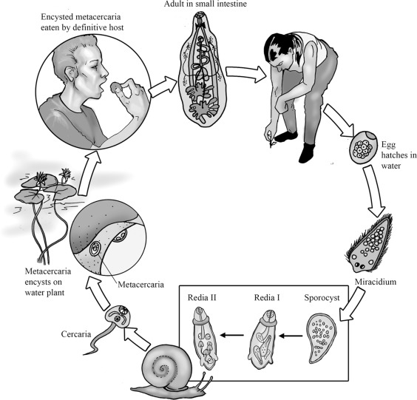
Background: Digenea (Platyhelminthes, Trematoda)
Parasitic Worms known for their two host life cycle
Intermediate hosts are very commonly molluscs, particularly snails (Gastropoda)
Infection is located in the gut of the snail
https://www.sciencedirect.com/topics/immunology-and-microbiology/digenea
Pechenik 2015, Esch and Fernandez 1994
Notes:
You could use some info about why this is relevant to human disease

Slide 4
Background: Microbiome
The community of bacteria associated with an organism
Help the host organism to digest food and interact with the immune system
Composition of the microbiome is shaped by the environment inside and around the organism
Carroll et al 2019
Notes:
https://www.ncbi.nlm.nih.gov/pmc/articles/PMC4056765/ Finf later
Look up more about microbiome
LEAVE ALONE

Slide 5
Introduction
There are very few studies on the interaction of between bacteria and parasites (at least in gastropods).
We chose Digenea and a freshwater snail population as a model for microbiome/parasite interaction due to local availability. The snails serve as a micro-ecosystem, and the parasites and bacteria should interact to some extent simply due to proximity.
If parasites and bacteria interact in any capacity , there should be differences in the microbiome between snails with and without parasites.

Slide 6
Hypothesis
Two main ways the microbiome could have differed:
Composition: the same species are present between groups but in different concentrations
Ex) Species A composes 95% of microbiome in parasite-free snails, but 16% of infected snails
Diversity: different species are present between groups
Ex) Species B is present in infected snails, but absent in parasite-free snails
Null Hypothesis: there are no significant differences between the microbiota
Notes:
LEAVE ALONE

Slide 7
Overarching Study Design
Two main groups: infected and uninfected snail
Individuals were dissected, isolated, PCR, and sequenced
Bacterial analysis was attempted, but ultimately failed
Parasites were identified genetically
Notes:
A flow chart or diagram would be very helpful on this slide it would be hard for anyone to follow what you are saying here without already knowing what you did. Before you get into methodological details, your audience should understand from this slide WHY you did what you did. For example - why did you dissect the snails? Why did you isolate DNA? etc.
Why did you dissect the snails?
Why did you isolate DNA?
Why PCR?
Why sequence?

Slide 8
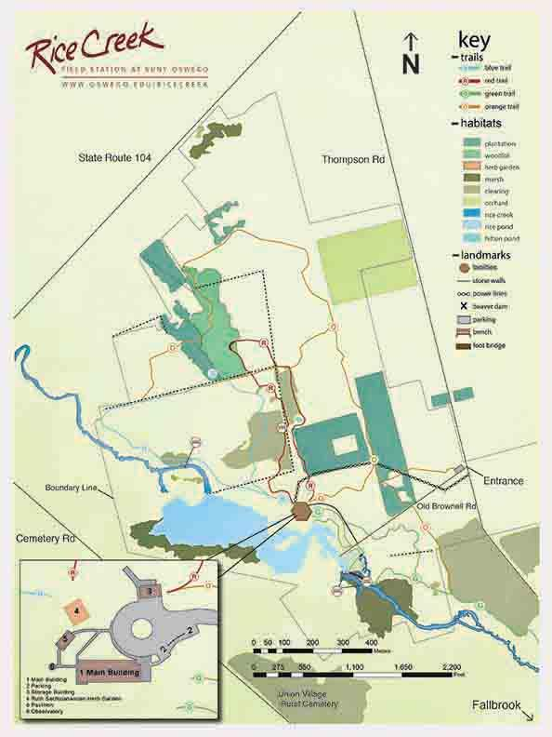
Collection
Two collection locations: Fallbrook and Rice Creek Green Trail
A total of 74 snails were collected (with permit)
Collection occurred over the summer (Late June - Late August)
https://www.oswego.edu/rice-creek/trails-overview
Notes:
LEAVE ALONE

Slide 9
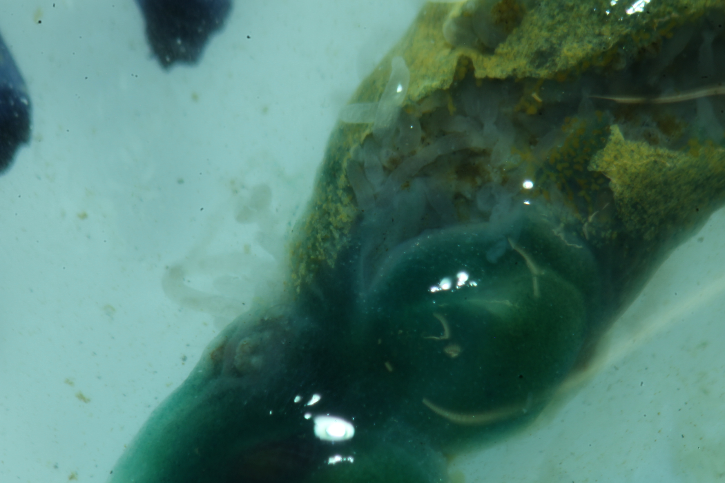
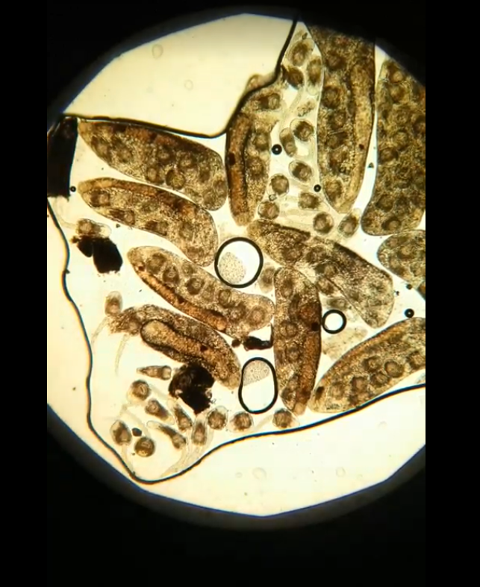
Dissection
Individuals were deshelled, and beheaded.
Parasite infection was identified by type (vermiform, and sporocyst and/or cercaria), most infections were heavy.
Sporocyst infections were coupled with cercaria. This is just how the life cycle works.
Spire was used for DNA isolation, as that contained both the bacterial and parasite samples.
Separate parasite sample were taken when possible for separate genetic analysis.
1
2
3
4
Picture 2: Vermiform, Pictures 1 and 4: cercaria, Picture 3: sporocyst and cercaria
Notes:
Define vermiform

Slide 10
DNA Isolation of Snail samples
WORKFLOW
Add T.E., 10%SDS, and homogenization beads to tissue sample. Shake vigorously.
Add NaCl and CTAB and incubate for 10 minutes.
Add proteinase K and incubate for 1 hour.
Alternate between adding chloroform:isoamyl and phenol-chloroform, putting liquid layer into a new tube each time.
Add isopropanol to precipitate DNA, then add ethanol to wash.
Phenol-chloroform protocol most efficient to remove proteins and polysaccharides
Mucopolysaccharides are PCR inhibitors
CTAB binds to mucopolysaccharides
Nishiguchi et al 2002, Sokolov 2000, Theodorakis 2014 and Winnepenninckx et al 1993
Notes:
Cassaro, C. M. F., Dietrich, C. P. (1977) “Distribution of Sulfated Mucopolysaccharides in Invertebrates” Journal of Biological Chemistry Vol. 252, No. 7, pg. 2254 - 2261
Holodniy, M., Kim, S., Katzenstein, D., Konrad, M., Groves, E., Merigan, T. C. (1991) “Inhibition of Human Immunodeficiency Virus Gene Amplification by Heparin” Journal of Clinical Microbiology Vol. 29, No. 4, pgs. 676 - 679
Nishiguchi, M.K. et al. (2002) "DNA isolation Procedures" in Techniques in Molecular Systematics and Evolution ed. Rob DeSalle et al. Birkhauser Verlag, Basel, Switzerland.
Sokolov, E. P. (2000) “An Improved Method for DNA Isolation from Mucopolysaccharide-rich Molluscan Tissues” Journal of Molluscan Studies Vol. 66, pgs.573 - 575
Winnepenninckx, B., Backeijau, T., DeWachter, R. (1993) “Extraction of High Molecular Weight DNA from Molluscs” Trends in Genetics Vol. 9, Issue 12, pgs. 407

Slide 11
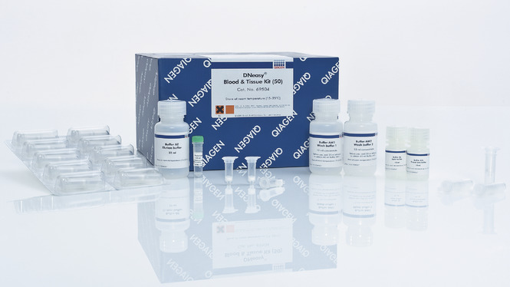
DNA Isolation of Parasite samples
The separated parasite samples were isolated using Qiagen’s DNeasy Blood + Tissue Kit.
The samples were washed twice with water to remove snail tissue remnants, then the manufacturer’s protocol was followed.
https://www.qiagen.com/br/products/top-sellers/dneasy-blood-and-tissue-kit/#orderinginformation
Notes:
Kya-gen
The parasites that were removed from the snail tissue during the dissection were isolated using the DNeasy Blood + Tissue Kit largely following the manufacturer's spin-column protocol for animal tissue. The samples were placed in a microcentrifuge tube with 180uL of the kit’s ATL Buffer and 20uL of proteinase K solution, then incubated at 56ºC until completely lysed with occasional vortexing to disperse the sample. 2 uL of RNase A with a concentration of 100mg/mL was added to the sample and vortex. They were left at room temperature for 2 minutes, then 200uL of Buffer AL was added and vortexed. The same was done with the addition of 100% ethanol. The samples were then placed in a filtered spin column with collection tube and centrifuged at 8,000 rpm for one minute. The collection tube and flow through was discarded and a new collection tube was placed onto the spin column. 500uL of Buffer AW1 was added to the column and treated as above. 500uL of Buffer AW2 was added and centrifuged at 14,000 rpm for three minutes. The spin column was then placed in a labeled 1.5 mL microcentrifuge tube. 30 uL of 60ºC Buffer AE was added to the column, let to sit at room temperature for one minute, then centrifuged at 8,000 rpm for 1 minute. This step was then repeated with the same amount of Buffer AE for full elution (MANUFACTURER PROTOCOL?, Newell, personal communication?).

Slide 12
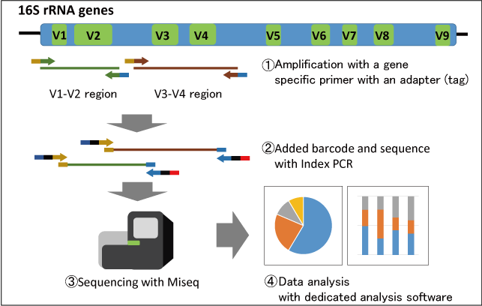
PCR of Bacteria
Uses primers and enzymes to copy specific fragments of DNA
Used to amplify the 16s gene that is common to most bacterial species
Was unsuccessful, mostly likely due to proportion
Adapted from https://www.repertoire.co.jp/

Slide 13
PCR of Parasites
18s rRNA gene was targeted
First tested primers for qPCR, this failed
Used a different primer pair to target whole gene in separated parasites, this was successful
Adapted from https://www.repertoire.co.jp

Slide 14
Sequence Analysis and Identification
F: 5’ - ATGTACAGTAGTAG - 3’
R: 3’ - ACTGGACATGATGA - 5’
F: 5’ - ATGTACAGTAGTAG - 3’
+
RC: 5’ - AGTAGTACAGGTCA- 3’
Joined Sequence:
5’ -ATGTACAGTAGTAGTACAGGTCA- 3’
The PCR result were purified using GeneJET PCR Purification Kit.
Sequences were outsourced
Used BLASTn default settings to identify the sequences
Three sequences were analyzed for each sample → the forward, reverse, and joined
Notes:
It is inaccurate to say that we are unable to do sequencing ‘in house’ because we do have those technologies and we did have the budget to do it. We chose the most cost-effective option. You tackle a bit too much in the audio of this slide. Is this methods, results, or discussion section? You give a bit from each. I recommend finish methods, then present results & discussion as a separate slide. The methods description would benefit from a diagram showing the PCR product and primers sequencing from either end.

Slide 15
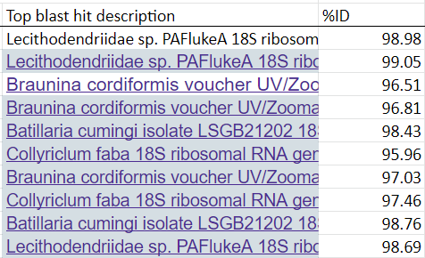
Results
Three digeneans were identified: Lecithodendriidae sp. PAFlukeA, Braunina condiformis, and Collyriclum faba
Some samples returned with high background, indicative of multiple PCR products
Some samples returned as Batillaria cumingi, a snail species
The top blast hits of the joined sequences with the percent identity of each individual.

Slide 16
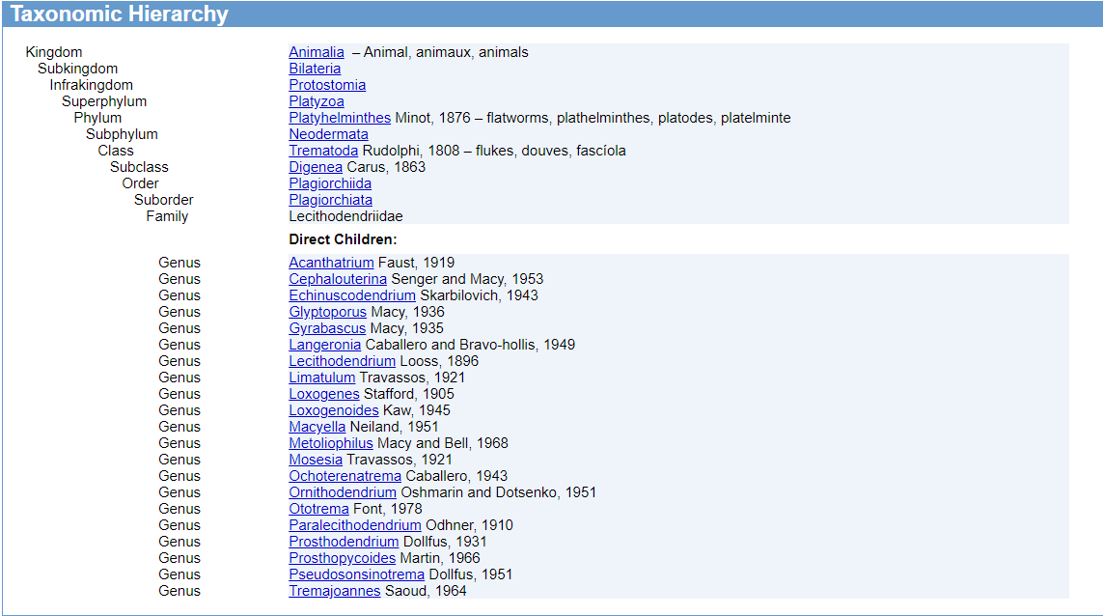
Lecithodendriidae sp. PAFlukeA
Specimens only identified up to Family
Mainly parasitize bats and occasionally birds (Lotz, J. M. & Font, W. F., 2008)
https://www.itis.gov/servlet/SingleRpt/SingleRpt?search_topic=TSN&search_value=56498#null
Notes:
Your description for this slide could be more clear. Plural of genus is genera. I understand what you mean by “how this would work” but your audience might not. Be explicit - this parasite could be infecting snails as an intermediate host, then the snail could be picked up by a bird, then the bird could be infected.

Slide 17
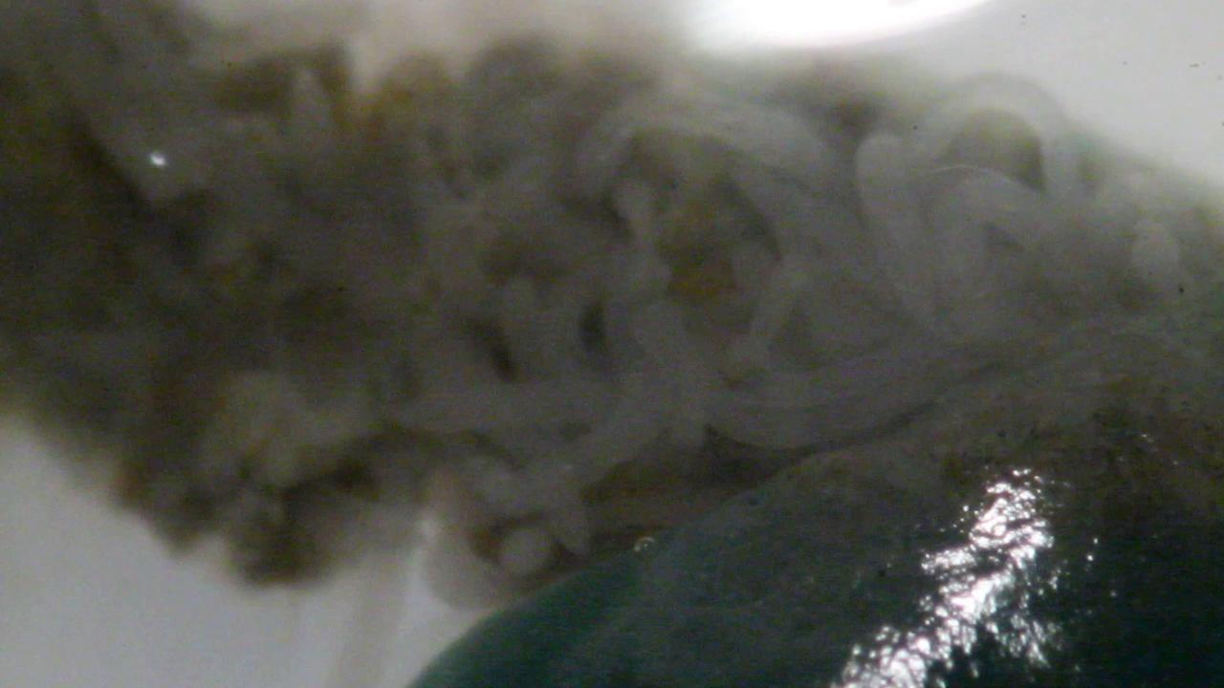
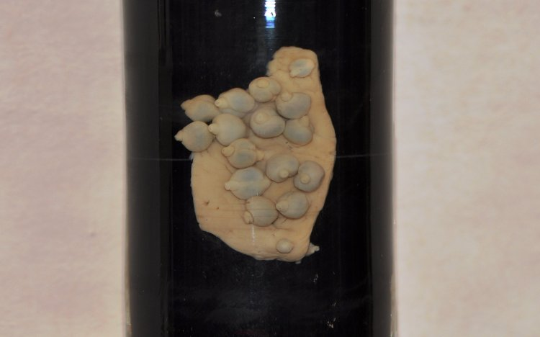
Braunina cordiformis
Observed as the vermiform sporocysts
Most of the literature involves dolphin hosts
We most likely found a close relative.
https://www.biolib.cz/en/taxon/id82031/
Notes:
Audio clip for this slide should be recorded again. Do other descriptions of this organism match the vermiform sporosyts you observed?? There has to be a description of this somewhere in the literature.

Slide 18
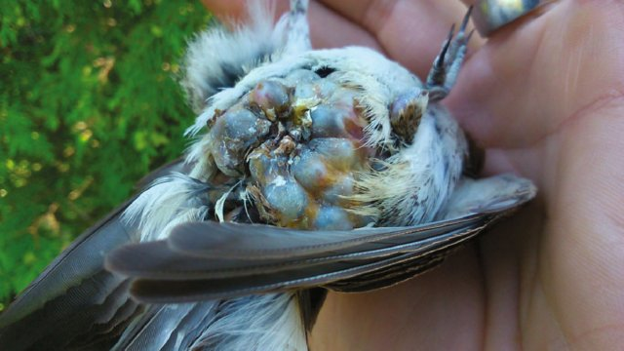
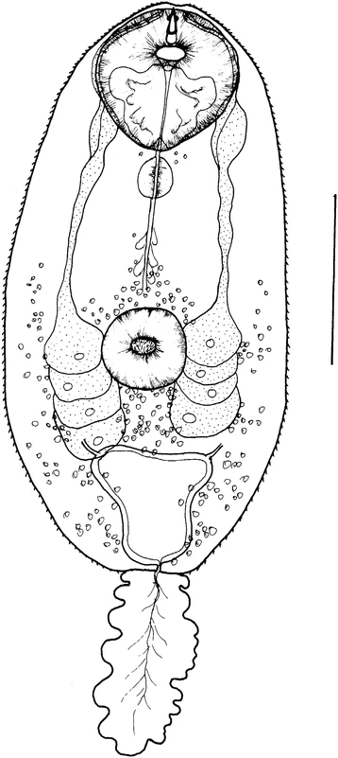
Collyriclum faba
Infects birds
A study by Heneberg et al. (2015) described the complete lifecycle of a Central European population.
Was observed to have two intermediate hosts, a snail and a mayfly
In definitive hosts, C. faba form cysts that can cause anemia and emaciation when abundant.
https://www.researchgate.net/publication/324601752_Collyriclosis_in_Red-backed_Shrikes_Lanius_Collurio_from_Israel_and_Czech_Republic/figures?lo=1
Cercaria of Collyriclum (Heneberg et al., 2015)
(Heneberg et al., 2015)

Slide 19
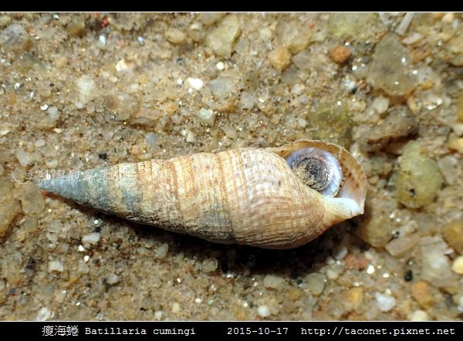
Conclusion
The bacterial communities of these snails are still unknown.
The snail species and parasites that were genetically identified are most likely close relatives to the collected specimens as the known attributes of the identified species are inconsistent with the collection environment.
https://taconet.pixnet.net/blog/post/47063644
Notes:
You need a summary slide providing conclusions and wrapping everything up. What steps would you take to move the study forward? How could we confirm the parasite/snail identifications?

Slide 20
Thank you to:
Peter Newell and Andrew McElwain for their guidance and help.
The Student Challenge Grant and RCA Small Grants for their support in this project.

Slide 21
If you have any questions, feel free to contact Rebecca Wolff at rwolff2@oswego.edu
or
Peter Newell at peter.newell@oswego.edu

Slide 22
Literature Citations
Carroll, C., Olsen, K. D., Ricks, N. J., Dill-McFArland, K. A., Suen, G., Robinson T. F., Chaston, J.M., (2019) “Bacterial Communities in the Alpaca Gastrointestinal Tract Vary With Diet and Body Site” Frontier in Microbiology Vol. 9, pgs. 33-34 https://www.frontiersin.org/article/10.3389/fmicb.2018.03334
Pechenik, J. A. (2015) Biology of the Invertebrates, Seventh Edition. McGraw-Hill Education pgs. 159-168
Winnepenninckx, B., Backeijau, T., DeWachter, R. (1993) “Extraction of High Molecular Weight DNA from Molluscs” Trends in Genetics Vol. 9, Issue 12, pgs. 407
Nishiguchi, M.K. et al. (2002) "DNA isolation Procedures" Techniques in Molecular Systematics and Evolution ed. Rob DeSalle et al. Birkhauser Verlag, Basel, Switzerland.
Sokolov, E. P. (2000) “An Improved Method for DNA Isolation from Mucopolysaccharide-rich Molluscan Tissues” Journal of Molluscan Studies Vol. 66, pgs. 573 - 575

Slide 23
Literature Citations
Theidorakis, C. W. (2014) Internet forum “What are the effects of carbohydrates in PCR?” ResearchGate https://www.researchgate.net/post/What_are_the_effects_of_carbohydrates_in_PCR
Esch, G. W., Fernandez, J. C., (1994) “Snail-trematode Interactions and Parasite Community Dynamics in Aquatic Systems: A Review” American Midland Naturalist Vol. 131, No. 2, pgs. 209-237
Lotz, J. M., Font, W. F. (2008) Family Lecithodendriidae Lühe, 1901. In Bray, R. A., Gibson, D. I., Jones, A. (Eds.) Keys to the Trematoda (Vol 3, pgs. 527-536). Doi: 10.10799780851995885.0527
Heneberg, P., Faltýnková, A., Bizos, J. et al. Intermediate hosts of the trematode Collyriclum faba (Plagiochiida: Collyriclidae) identified by an integrated morphological and genetic approach. Parasites Vectors 8, 85 (2015). https://doi.org/10.1186/s13071-015-0646-3

